Slide 1

Airline tweets sentiment analysis
Wirach (Joe) Leelakiatiwong

Slide 2
Table of Contents
01
02
03
04
The Problem
Why sentiment analysis?
The Data
What data do we have?
The approach
How can we flag negative sentiment?
The Conclusion
Model performance and further improvements

Slide 3
A little bit of background

Slide 4

Twitter
Twitter is a 'microblogging' system that allows you to send and receive short posts called tweets. Tweets can be up to 280 characters long and can include links to relevant websites and resources.
https://esrc.ukri.org/research/impact-toolkit/social-media/twitter/what-is-twitter/

Slide 5
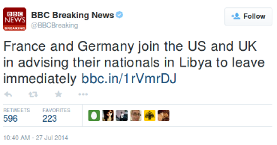
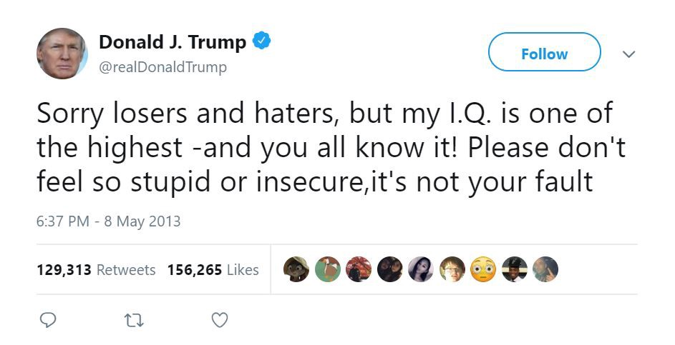
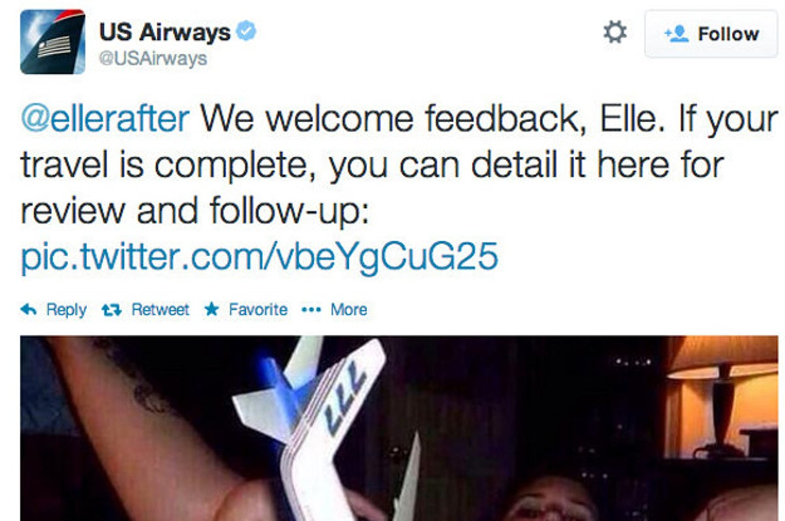

Slide 6
Sentiment Analysis
@AmericanAir Love the new planes for the JFK-LAX run. Maybe one day I will be on one where the amenities all function. #NoCharge #Ever
@AmericanAir leaving over 20 minutes Late Flight. No warnings or communication until we were 15 minutes Late Flight. That's called shitty customer svc
Sentiment analysis is a natural language processing technique used to determine whether data is positive, negative or neutral to help businesses monitor brand and product sentiment in customer feedback, and understand customer needs.
https://monkeylearn.com/sentiment-analysis/

Slide 7
01
The Problem

Slide 8
"Although airline industry — one of the world most competitive market — have been employing multiple feedback channels to collect customer feedback, they are all arduous. Thus making a social media analysis a more compelling approach. This project will identify negative sentiment tweets about the airline to categorize them into subcategories and direct them to related departments to solve problems and develop improvement strategies in the future."
Notes:
An airline industry — one of the world most competitive market—have been exploring numerous attempt to improve customer satisfaction. Therefore, understanding customer needs via feedback analysis is essential. Although multiple feedback channels such as hotline, direct email, journey report have been employed, they are all arduous. Thus making a social media analysis a more compelling approach. This project will focus on identifying negative sentiment tweets about the airline and categorize them into subcategories and direct them to related departments to solve problems and developing improvement strategies promptly.”

Slide 9
02
The Data

Slide 10
Data: Twitter US Airline Sentiment dataset (Kaggle)
Coverage
Airlines
Size
Data was collected from 16th to 24th February of 2015
Covered 6 major airlines in the USA
(United, US Airways, American Airlines, Southwest, Delta, Virgin)
Rows : 14640
Columns : 15

Slide 12
Data Dictionary (in the scope of project)
Twitter Dataset
Features
Text
Metadata
Sentiment
(Target Variables)
Tweet messages
Post date and time
Positive/Neutral
Negative

Slide 13
Exploratory Data Analysis

Slide 14
Data Overview
63 %
Negative sentiment
37%
Positive / Neutral
Sentiment

Slide 15
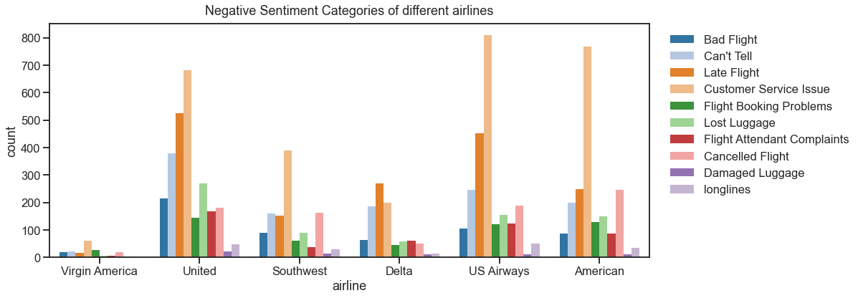
Airlines Overview

Slide 16
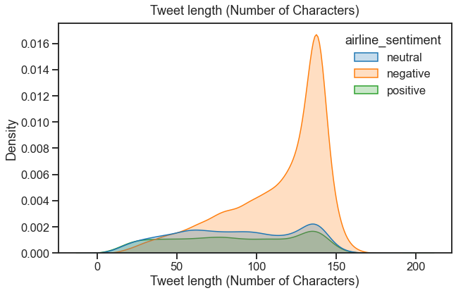
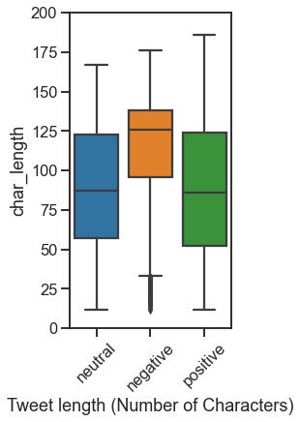
Tweet length (#characters)

Slide 17
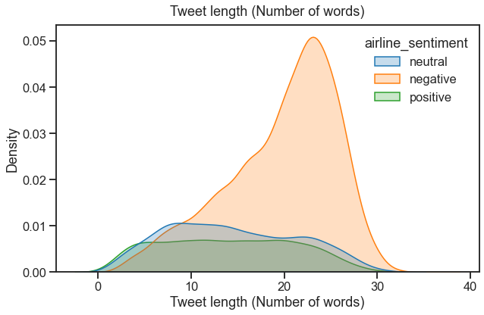
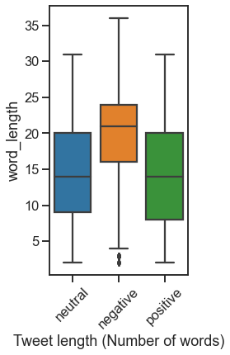
Tweet length (#words)

Slide 18
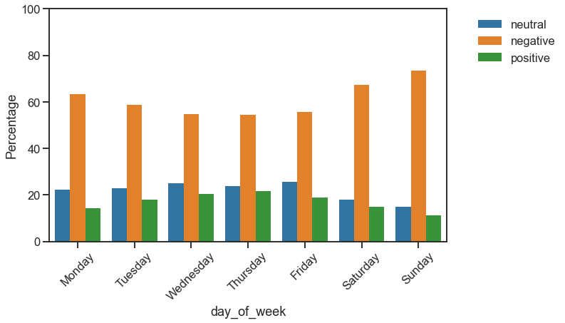
Days of week

Slide 19
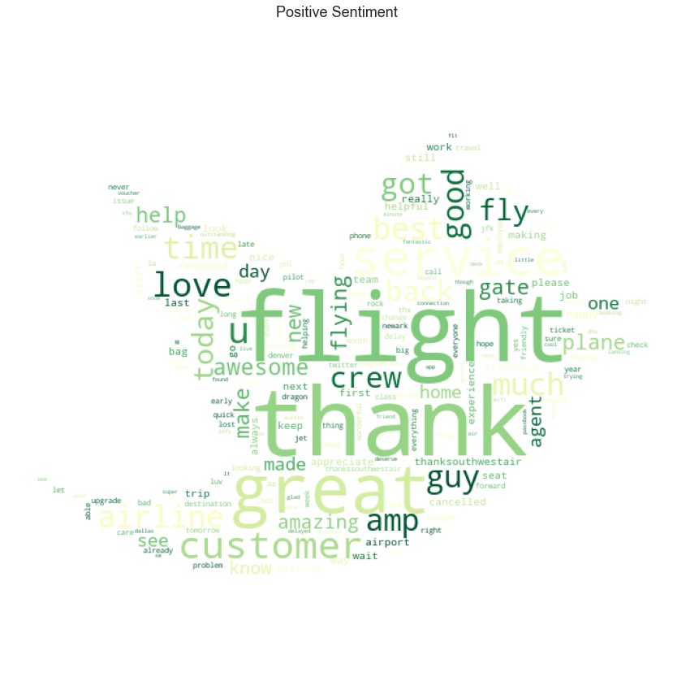
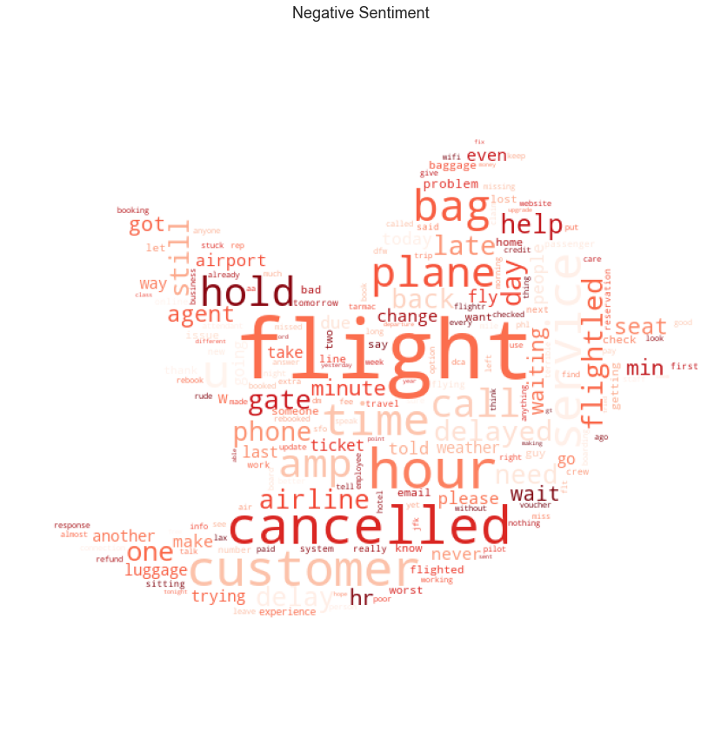
Negative vs Positive Sentiment words
Positive Sentiment
Negative Sentiment

Slide 20
03
The Approach

Slide 21
Algorithm outline
Metamodel
Textual model
“Take metadata such as day of week, tweet length as input”
“Take processed tweet as input”
Combined model
“Combine prediction from both model and predict final probability”
*Baseline Accuracy = 62.7%

Slide 22
Text Data Preprocessing
Hello, this is a TEST message for aviation Lover “forums”. please visit at (https://americanairlines.com)
#awesomeairline
hello, this is a test message for aviation lover “forums”. please visit at (https://americanairlines.com)
#awesomeairline
hello this is a test message for aviation lover forums please visit at #awesomeairline
convert to lower
Remove HTML / special char.
Segment
hashtag
Remove stopwords
Remove airline
entity
hello this is a test message for aviation lover forums please visit at awesome airline
hello this is a test message for aviation lover forums please visit at airline
hello test message aviation lover forums please visit airline
Lemmatize
hello test message aviation love forum please visit airline
0.26 0.47 0.56 0.34 0.23 0.52 …
Vectorize

Slide 23
The Result
One-hot encoding
Standardizing
Preprocessed Metadata
Metamodel (LogisticRegression)
Train/Test accuracy : 71/72
Vectorizing
Combined model
(LogisticRegression)
(TF-IDF*)
Preprocessed Textual data
Train/Test accuracy : 88/84
Texual model
(LogisticRegression)
*TF-IDF
TfidfVectorizer = Term frequency (TF) x Inverse of Document Frequency (IDF)
Term frequency = How frequence of the word occured in that document
Document frequency = How frequence of the document containing that word
Words that occur often in one document but don't occur in many documents contain more predictive power (will get high vectorized value)
Train/Test accuracy : 87/83

Slide 24
04
The Conclusion

Slide 25
Performance Summary
Combined model
Combine prediction from both models
Textual model
Learned from tweet messages
Metamodel
Learned from metadata
84.2 % Accuracy
83.5 % Accuracy
72.1 % Accuracy
Baseline accuracy
62.7%

Slide 26
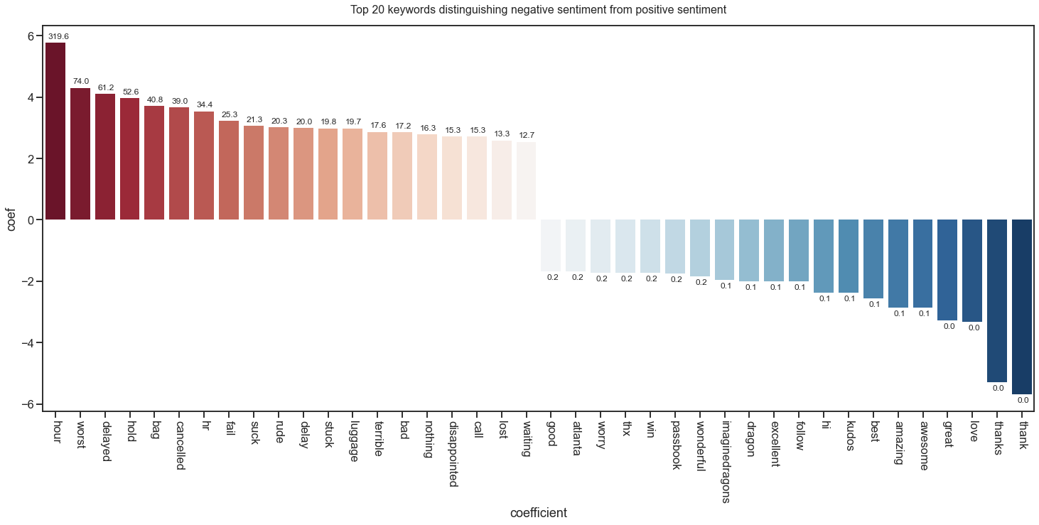
What can be infered from the model?
Notes:
By looking at the log coefficient I picked up...
- the top 20 keywords describing negative sentiment as plotted in red shaded bars
- the top 20 keywords indicating positive sentiment as plotted in blue shaded bars
We can see that tweets containing keywords such as **[hour, hr, delayed, delay, hold, cancelled] and/or [worst, fail, suck, rude, terrible, bad, disappointed]** will likely to be a negative sentiment tweet

Slide 27
Limitation
Customer services was horrible
88.2% probability of being negative sentiment
The landing was perfect!
20.3% probability of being negative sentiment
Although the departure was delayed, at least we are able to arrive on time
77.0% probability of being negative sentiment
Notes:
Our model were built using tf-idf vectorizer, which simply counting word frequency and document frequency. Bag-of-words representations discard grammar, order, and structure in the text but track only occurrences.
Therefore sentences including if-else clause, contrasting conjunction which could included both positive and negative keywords can confuse the model

Slide 28
Conclusion
How can it be used?
Limitation
01
02
Hooked with the data pipeline to filter the negative sentiment
A bag of words model may not effectively predict complex sentences
Further improvement
(The data)
Further improvement
(The model)
03
04
Gathering data from extended time span
Acquiring more data to train deep learning model
Train more complex model (require massive dataset)
Build classifier to subcategorize negative feedbacks

Slide 29
Extra
Topic modeling

Slide 30
Without topic modeling
Customer services
Too many things flow to my desk!
Lost and found
Ticketing
Customer complains never reach me!
What can I do with the lost and found problem?

Slide 31
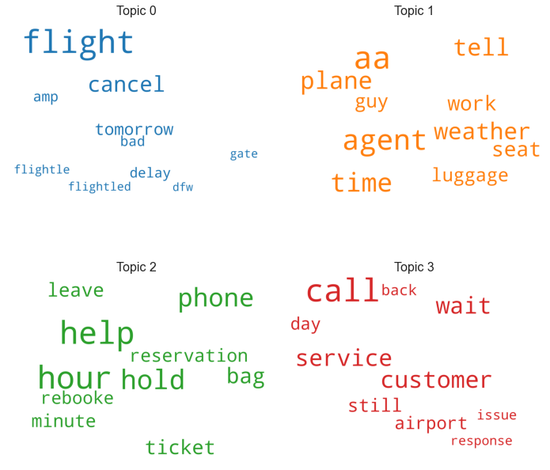
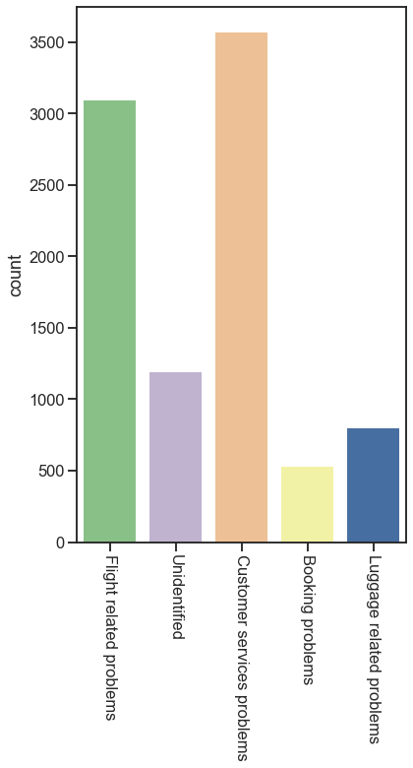
Ground truth and topic modeling result
Ground truth
Notes:
Our model were built using tf-idf vectorizer, which simply counting word frequency and document frequency. Bag-of-words representations discard grammar, order, and structure in the text but track only occurrences.
Therefore sentences including if-else clause, contrasting conjunction which could included both positive and negative keywords can confuse the model

Slide 32
What can topic modeling do?
Sentiment Classifier
Problems Classifier
Enormous pool of tweet mentioning our airline
Customer services
Negative Sentiment
Lost and Found
Subcategory of problems
Ticketing
Marketing
Future scope
Topic modeling

Slide 33
Thanks!
Do you have any questions?
Wirach.lee@gmail.com
+66 81 453 6326
Please keep this slide for attribution

